Slide 1
DEPLOYING WORDPRESS WEB APPLICATIOON ON LINUX UBUNTU MACHINE

Slide 2
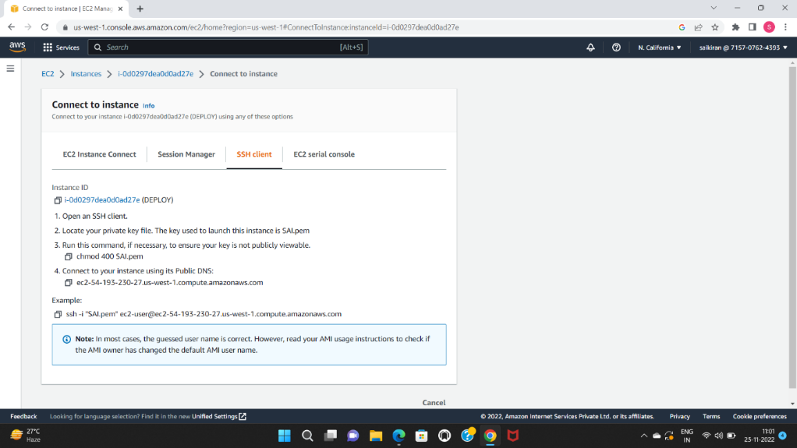
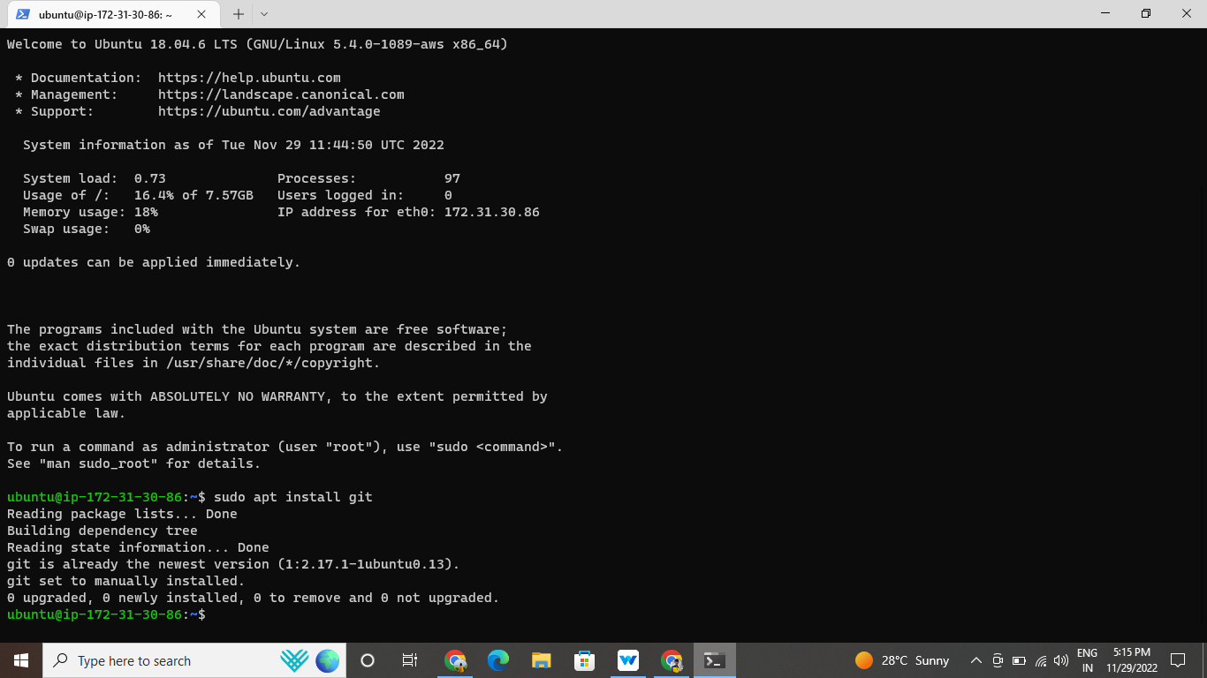
Create an EC2 instance with a Linux machine. Using ubuntu
The security group for
Inbound rules as SSH-22, HTTP-80, HTTPS-443
Outbound rules as ALL TRAFFIC
connect the instance to the terminal.

Slide 3
INSTALLING GIT,
Sudo apt install git command used to install git in local repositor

Slide 4
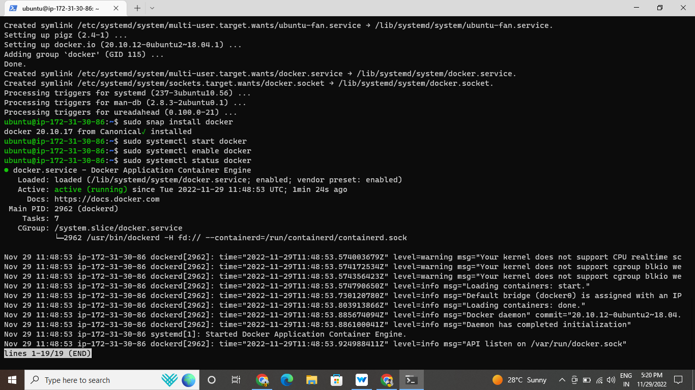
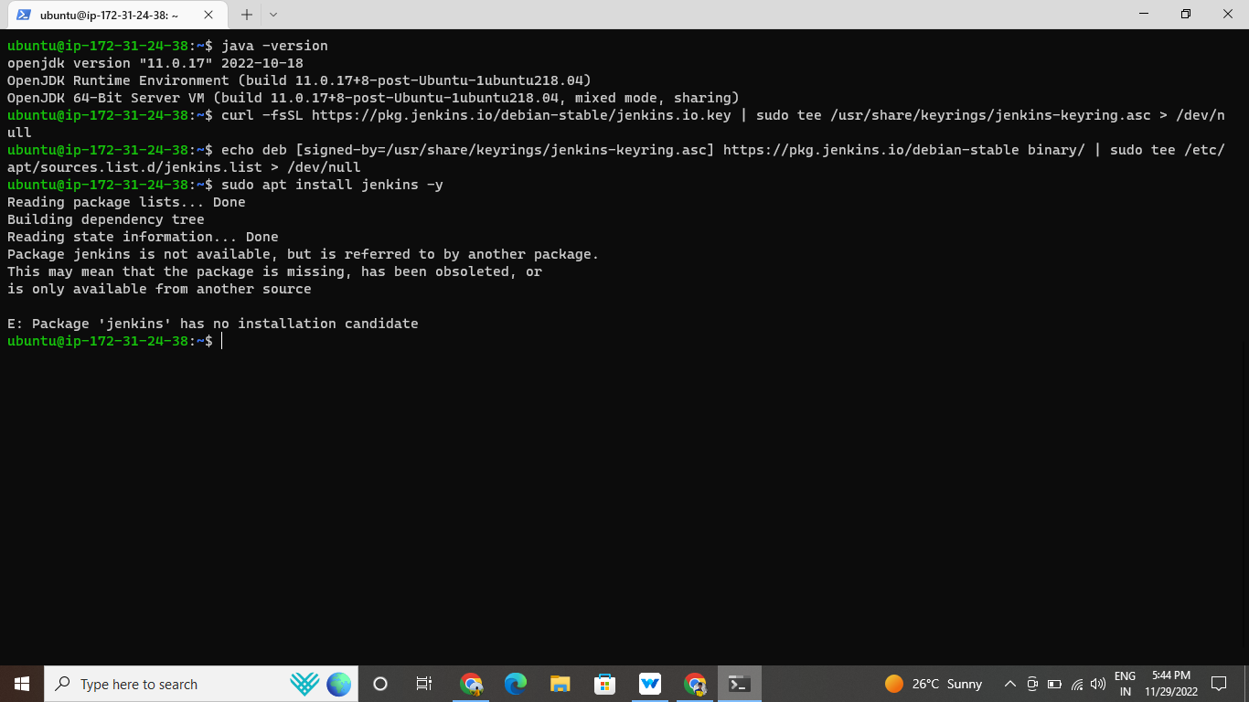
Install Docker and Docker compose in local repository

Slide 5
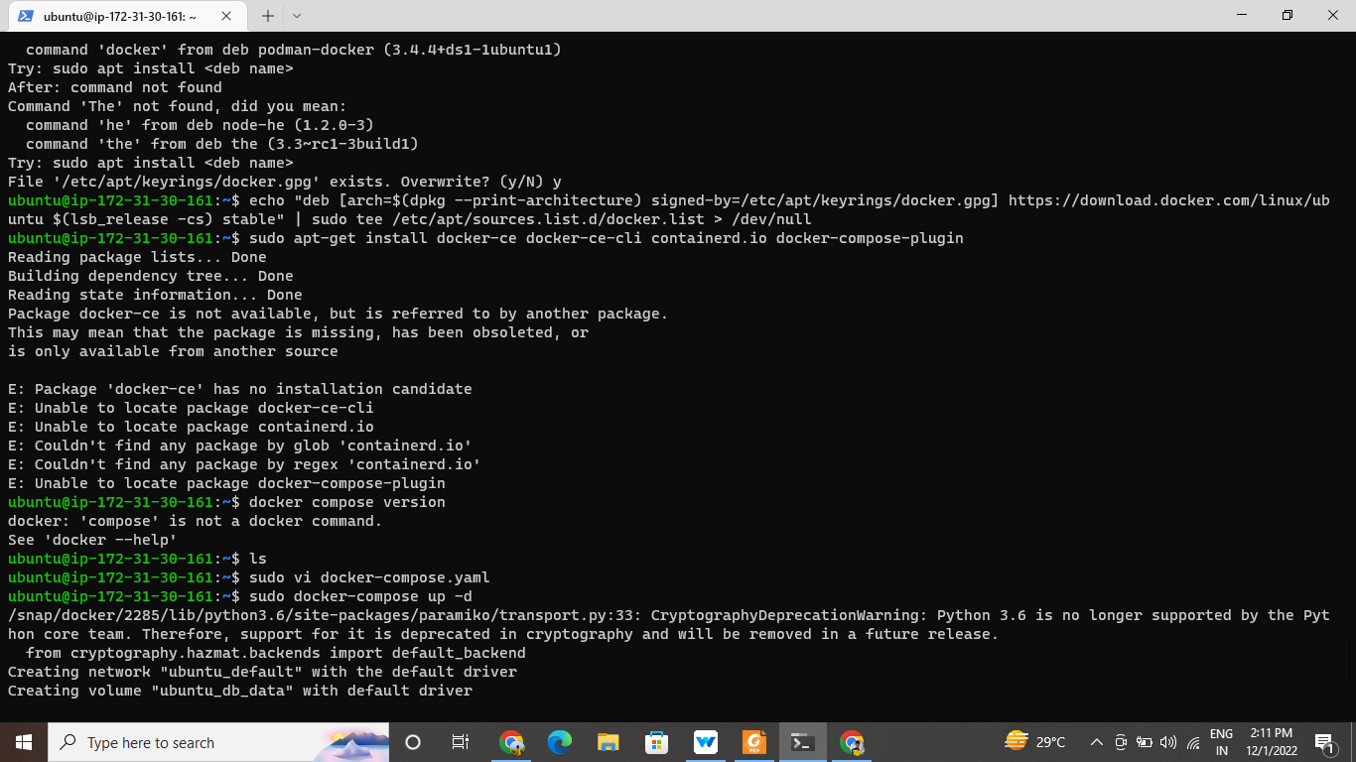

Slide 6
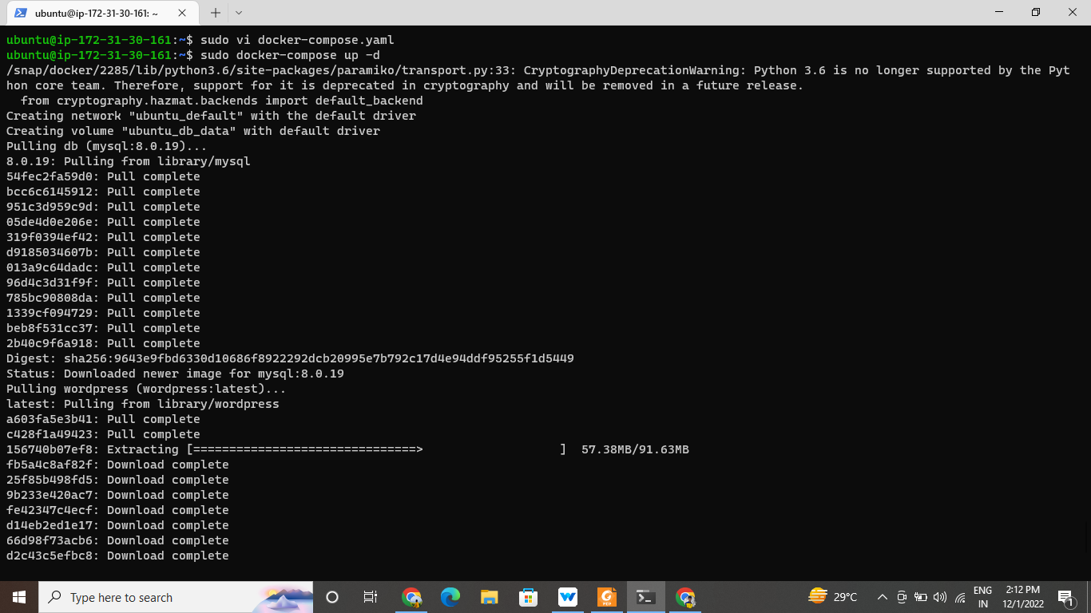
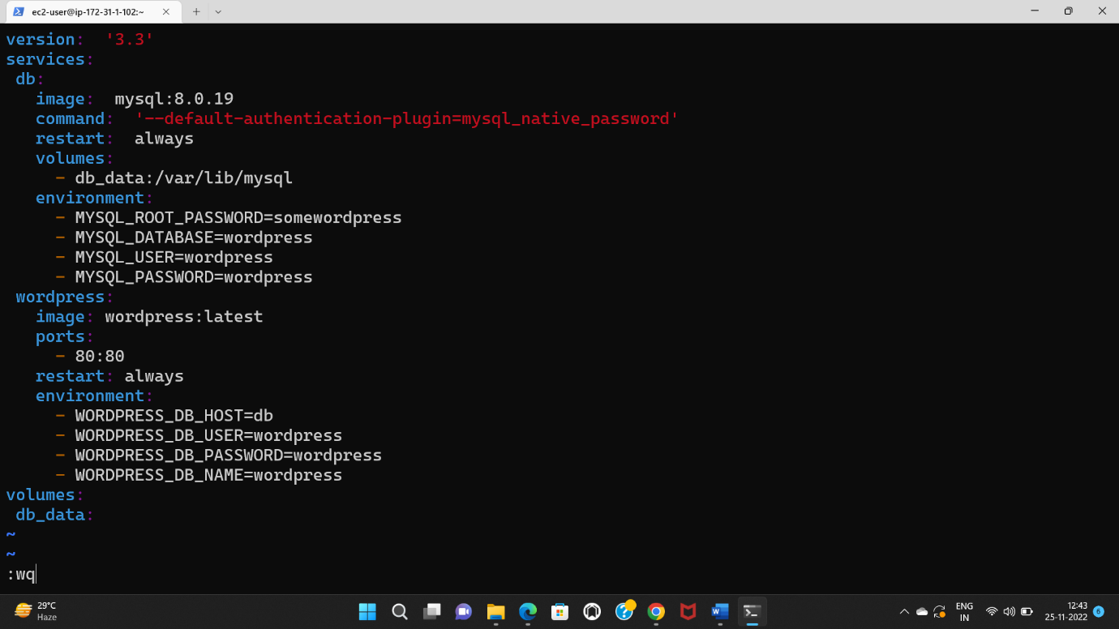
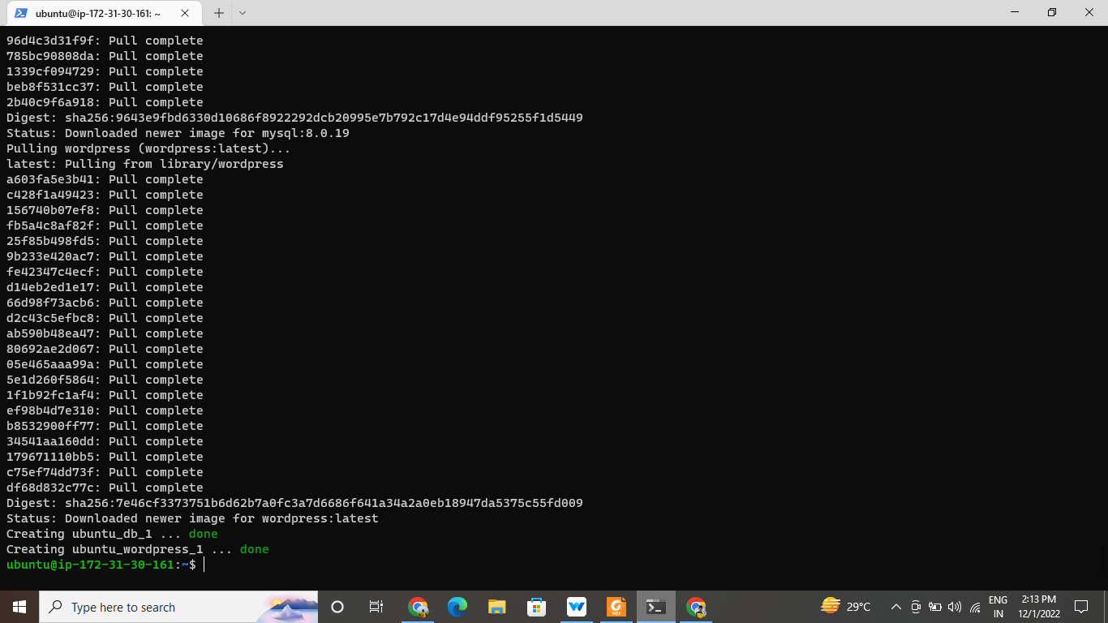

Slide 7
Create an EC2 instance with a Linux machine. Using Ubuntu
The security group for
Inbound rules as SSH-22, HTTP-80, HTTPS-443
Outbound rules as ALL TRAFFIC
connect the instance to the terminal
Install git, docker, java,
and jenkins

Slide 8
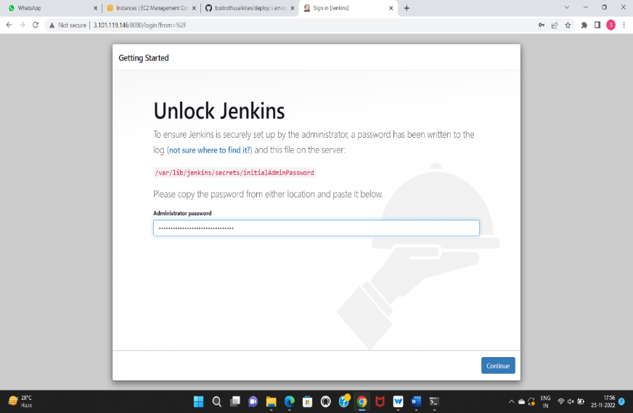
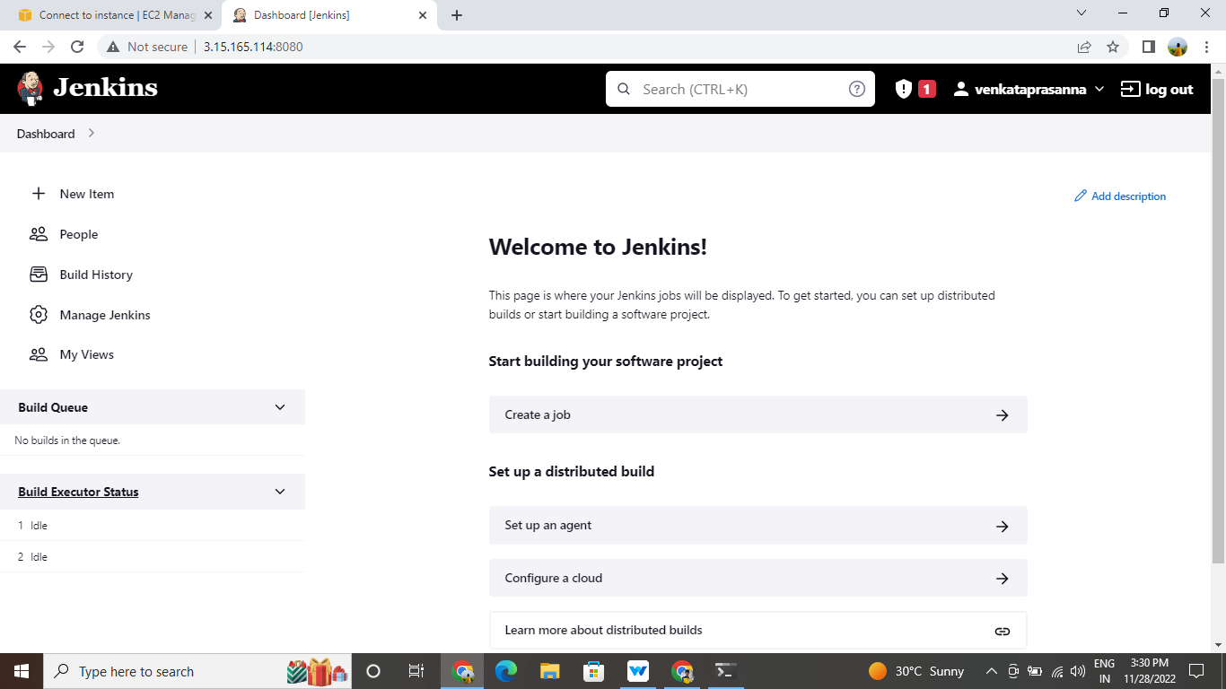
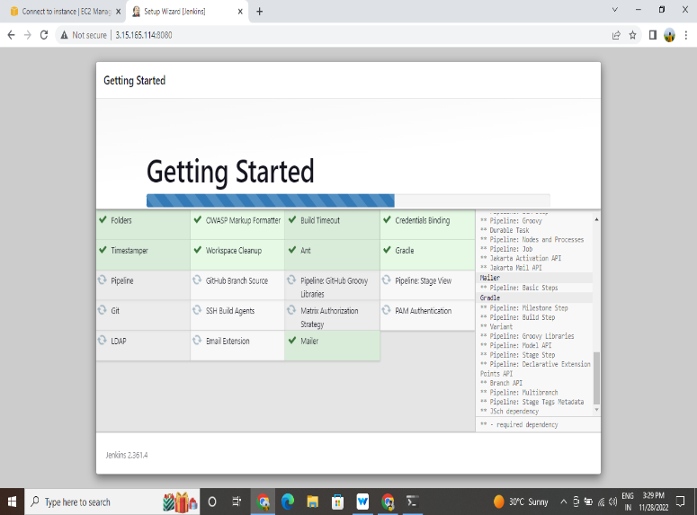
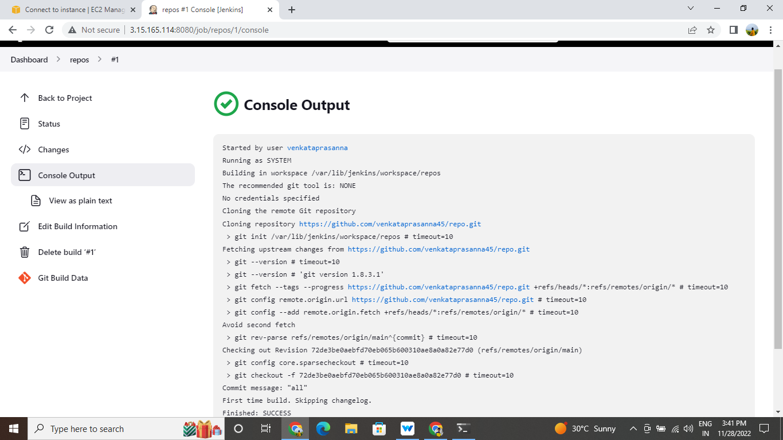
Jenkins web application

Slide 9
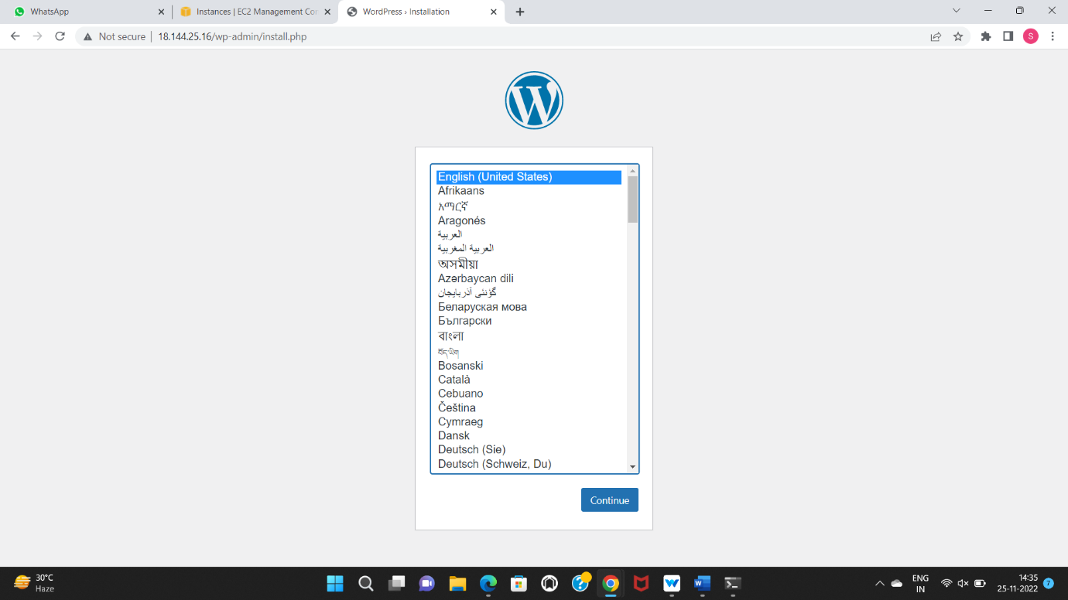
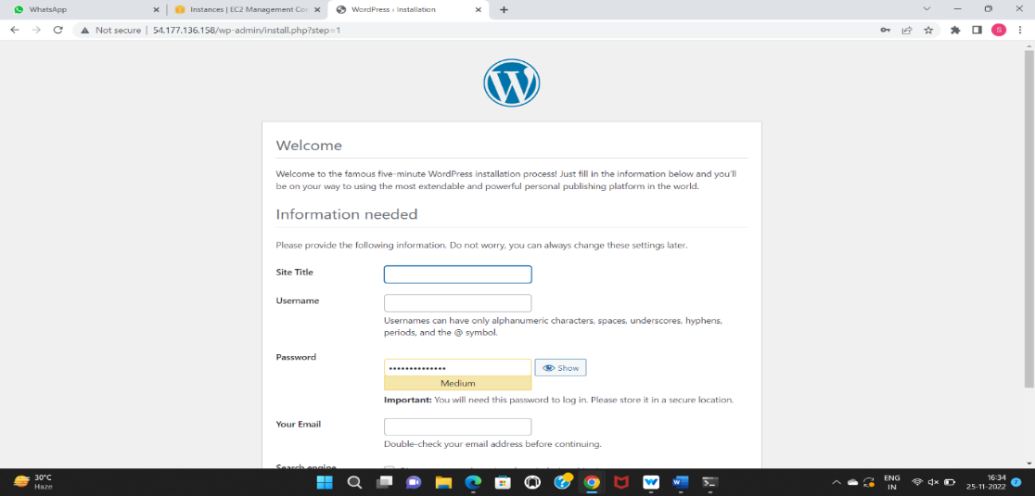
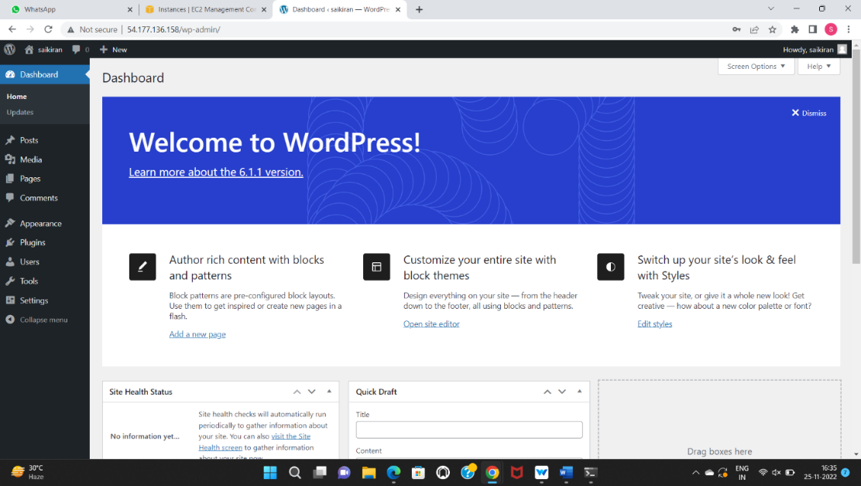

Slide 10


